Slide 1


Walmart Element

Slide 2

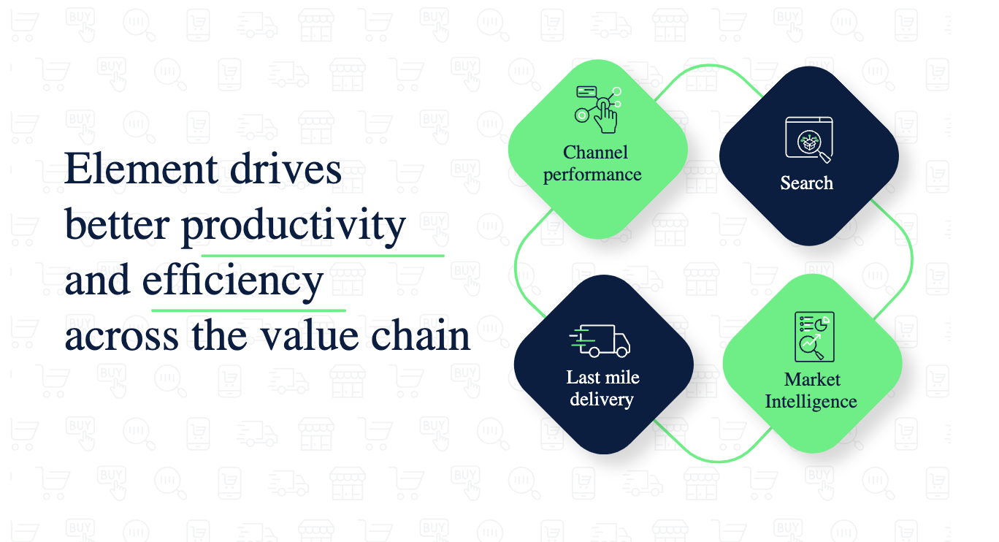
Walmart Global Tech is Walmart's technology and innovation division, which is dedicated to advancing the company’s digital capabilities to improve retail experiences for customers and streamline operations Walmart Global tech leverages technologies like AI/ML, cloud, 5G, voice and computer vision to build technology in retail industry to make retail easier, smarter and more affordable
About Walmart Element
Walmart Element is a machine learning platform developed to leverage machine learning and AI in global operations.
Element drives effective productivity and efficiency across value chain
Walmart started Element due to the following challengers
Vendor lock-ins
Exorbitant license cost and fees
Limited availability and reliability
Customization issues

Slide 3
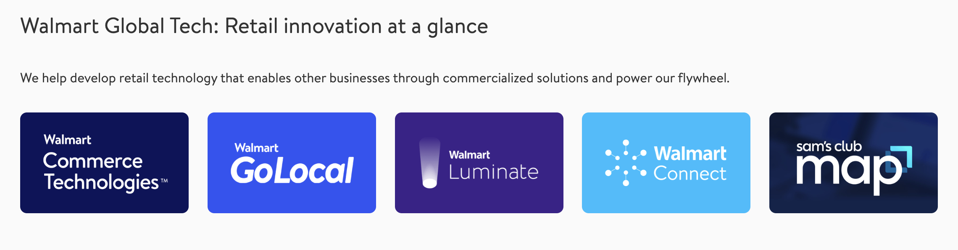
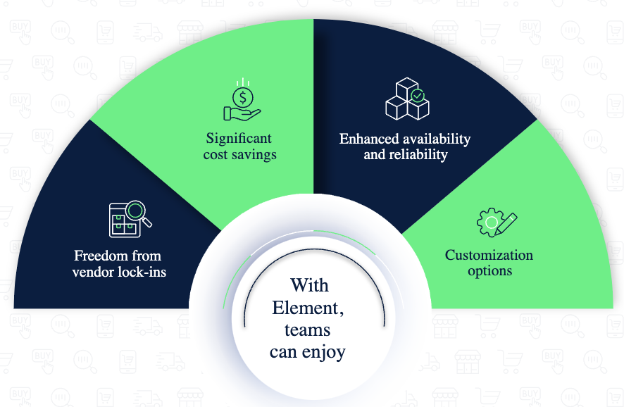
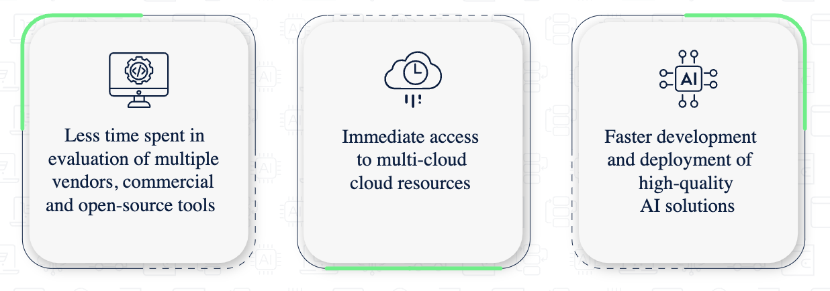
Accelerating innovation internally through Element
Element helps simplify the adoption of AI/ML at scale.
This reduces time to market by deploying faster solutions.

Slide 4
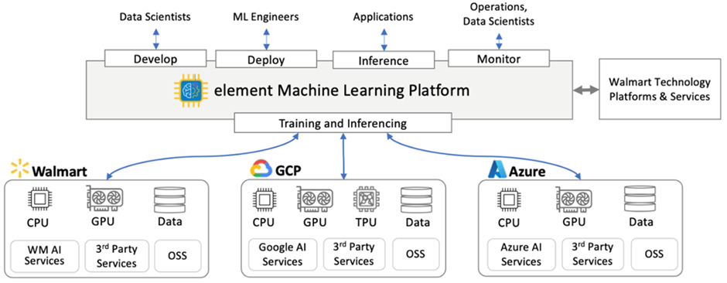
Element ML Platform Deployment Architecture

Slide 5
Problem Statement
Should Walmart keep Walmart Element as an internal tool to support its own operations, or should it commercialize the platform, making it available as a product for the external market?
Product Strategy
The product strategy for Walmart Element, should align with both Walmart’s broader business objectives and the potential market opportunity of the platform. The strategy needs to consider internal optimization, external commercialization, and customer-centricity.
Value-driven solutions to both internal Walmart teams and external customers, focusing on solving complex business challenges across value chains.
Internal Objective: Enhance Walmart’s operational efficiency, enabling data-driven decision-making and better resource allocation.
External Objective: Expand Walmart Element as an offering, helping retailers and other industries use machine learning to solve similar challenges.

Slide 6
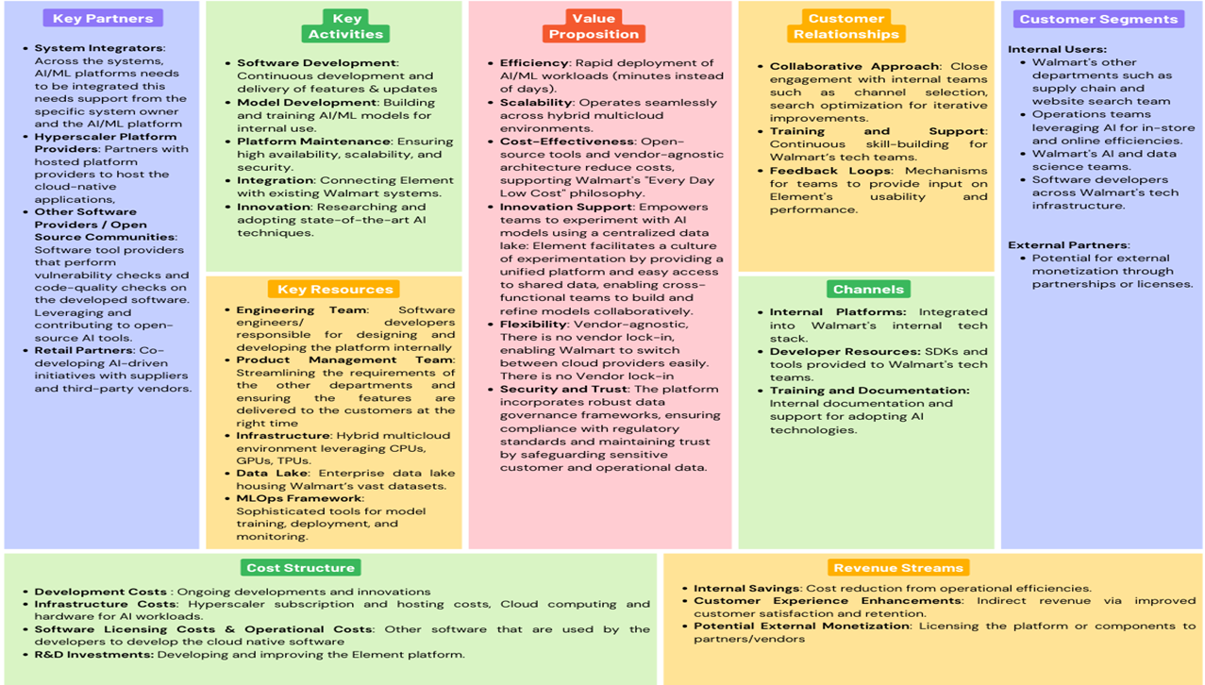
Business Model Canvas

Slide 7
Product Vision, Strategy and Roadmap
Vision
Provide competitive advantage by developing transformational ML platform capabilities that simplify the adoption of AI/ML
Key results (Short term)
Onboard 30% of Walmart’s top vendors
Achieve 100% data integration
Ensure 90% of vendors complete onboarding
Product Strategy
Target Audience: Internal and external vendors, retailers. Small firms with ecommerce presence
Value Proposition: Internal optimization, External SaaS
Differentiation: AI driven solution tailored for retail and supply chain
Product Roadmap
Short Mid Long
Internal Adoption Vendor Adoption Early market cap
Data Integration Feature Enhancement Full SaaS Launch
Vendor onboarding Scalability
Feature Expansion

Slide 8
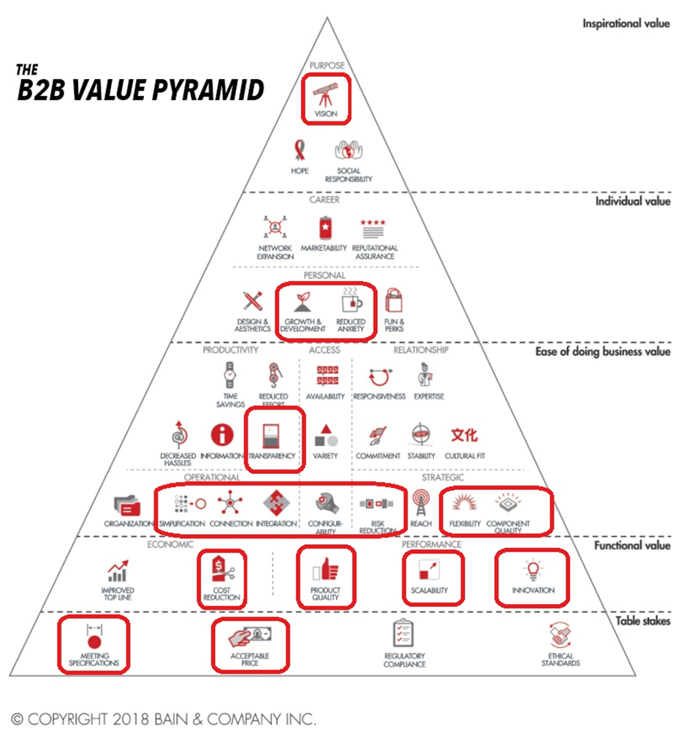
B2B Value Pyramid
Build on the concept of Maslow's Hierarchy of Needs with Vision as the inspirational value
Helps to achieve personal growth and reduces anxiety by automating the daily needs transparently.
Provides ease of doing business with superior integration, connectivity enabling flexibility and enhancing quality of work. Simultaneously it helps in cost reduction, scalability and fosters innovation at an acceptable price.

Slide 9
Bowling Alley Product-Market Fit Strategy
Walmart Element can incrementally build momentum and achieve Product-Market Fit. This process involves a gradual expansion from niche adoption to larger market penetration, which will be essential for long-term success.
Product Development
Deliver Value & Build Success Stories
Offer value-driven solutions to these niches (e.g., inventory optimization, demand forecasting) and build case studies.
Iterate and Optimize Based on Feedback
Continuously refine Walmart Element based on feedback from early users and ensure the platform addresses their specific needs.
Broader Market Adoption
Market Development
New Niches – Logistics, Manufacturing
Chasm
Top vendors

Slide 10
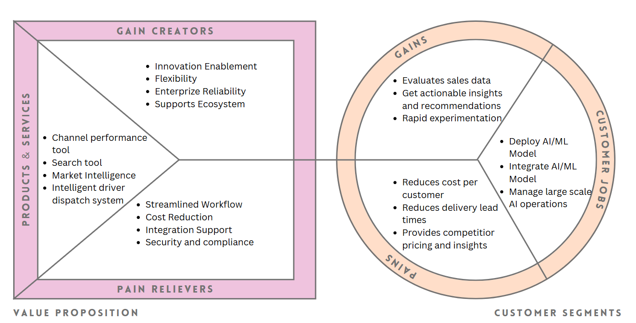
Value Business and Value Bundle
It helps teams quickly deploy AI/ML models, work efficiently across multiple cloud systems, and save costs using open-source and flexible architecture. Centralizing data and maintaining strong security, allows Walmart's teams to try new ideas and make smart, data-driven decisions

Slide 11
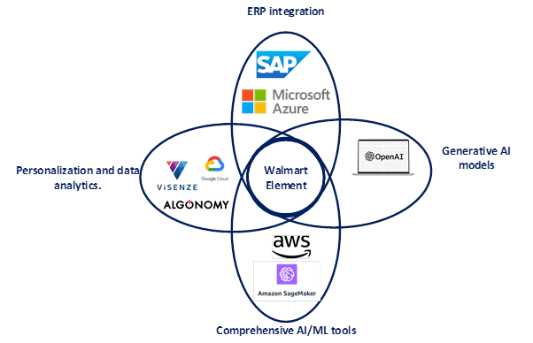
Petal Framework
Scalability
Visual Clarity
Growth Strategy
Focus on Value

Slide 12
Competitor Analysis
Competitor | Strengths | Competitive Edge
Amazon Web Services (AWS) | Comprehensive AI/ML tools like SageMaker, Rekognition, and Personalize. | Retail expertise as the backbone of Amazon; cost-efficient and scalable AI services
Google Cloud Platform (GCP) | Tools like Vertex AI, AutoML, and BigQuery ML for personalization and data analytics. | Advanced NLP and search technologies tailored for retail and supply chain
Microsoft Azure | Azure Machine Learning, Cognitive Services, and ERP integration through Dynamics 365. | Seamless integration with enterprise ecosystems and real-time analytics​
SAP AI Solutions | AI-enabled ERP, supply chain optimization, and business process integration. | Unified AI solutions tailored to large-scale retail operations​
OpenAI Solutions | Generative AI models like ChatGPT for conversational shopping and dynamic recommendations. | Flexibility for integration into various retail platforms, including startups
Retail AI Startups | Focus on niche applications like visual search (ViSenze), personalized marketing (Algonomy). | Specialized, agile solutions for specific retail challenges​

Slide 13
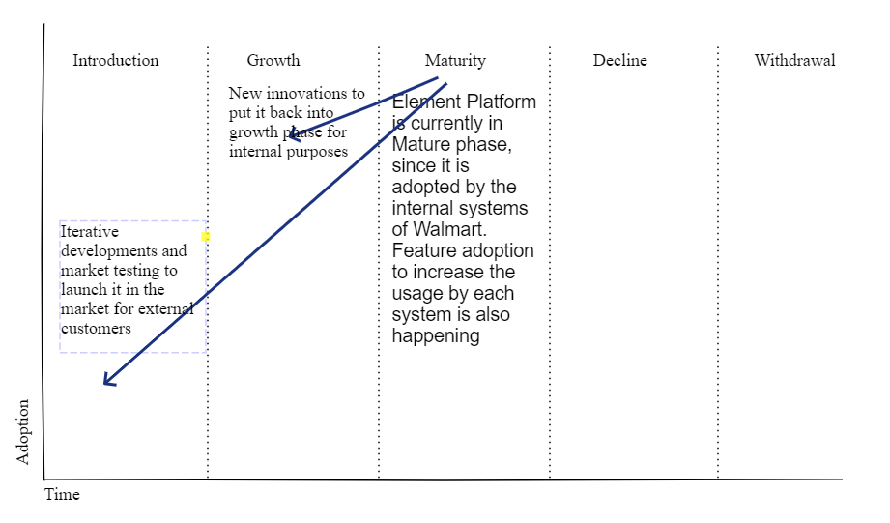
Product Life Cycle Management
Its lifecycle as an internal product has reached a maturity phase, characterized by widespread adoption across Walmart's internal systems. This maturity is reflected in several ways:
Adoption Across Teams
Increasing Feature Adoption
Stagnation in innovation.
If Walmart decides to launch Element as an external product, the lifecycle must restart at the introduction phase. This requires:
Identifying target customers and market segments.
Refining the platform for external usability, such as user-friendly interfaces and support infrastructure.
Establishing branding, pricing models, and marketing strategies to position the product competitively in the market.
Such a transformation demands iterative development and market testing to ensure Element aligns with external customer needs while retaining its competitive edge.

Slide 14

Recommendations
Considering the well-versed people with Walmart Element and the costs incurred for revamping the existing solution, we recommend the product should be continued for internal usage.
Start with niche markets like Walmart’s suppliers in retail or e-commerce which would enhance relationships, build case studies, and expand to adjacent industries for smooth adoption.
Pricing with Metering as a Service: Implement usage-based pricing with flexible tiers, tracking consumption metrics for transparent billing and cost optimization.
Generative AI: Integrate AI tools that allow businesses to customize models for specific tasks like inventory or demand forecasting, enhancing automation.
Domain-Specific ML Models: Offer pre-trained, industry-specific ML models as APIs to simplify integration and speed time-to-value.
Partnerships and Ecosystem: Partner with cloud providers and consultants to extend functionality and help businesses integrate Element.

